Slide 1
Waste management – citizens engagement
Fragiskos Fourlas (1059336)
Marios Stamatopoulos (1059383)
Nikos Panagiotopoulos (1053552)

Slide 2
OUTLINE
Problem
Solution
Market Fill
Market Gap
Our Proposal

Slide 3
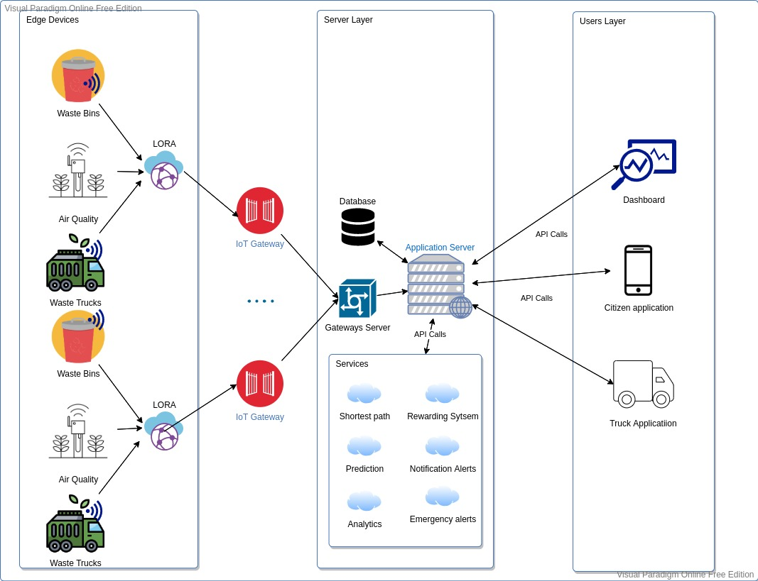
Our Proposal

Slide 4
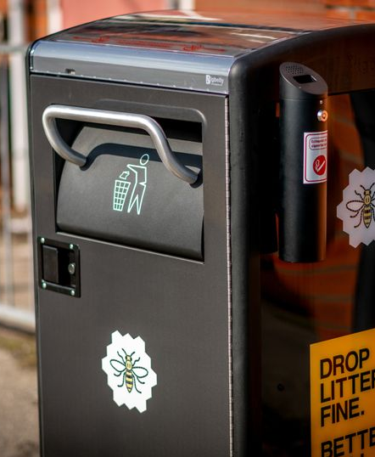
Dummy Sensors
Dummy Sensors Server
Collects data from the gateway and publishes it to the server
Handles API calls for I/O
Sensor Gateway
Works in the place of an actual IoT Gateway
Runs processes containing sensors
Transfers messages between sensors and server via pipes
Sensors
Have a unique identifying UUIDv4
Scatter themselves around a fixed center point
Update and publish mock data with a unique “measurement ID” each interval
Chance to fall or catch fire every interval

Slide 5
Regression Prediction
Sadas
SFSDFSaasf

